Slide 1

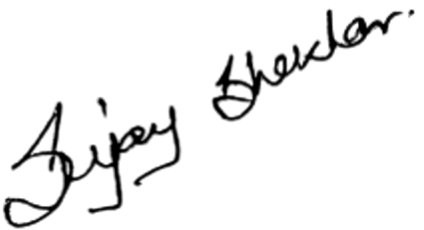
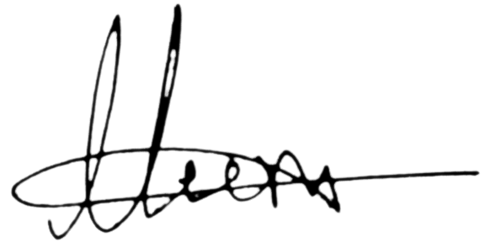
S.NO: ISM/IT/
INTERNATIONAL SCHOOL OF MANAGEMENT
Approved by AICTE (Ministry of HRD, Govt. of India)
CERTIFICATE
This is to certify that
of
has participated in the organized by R & D Committee
on the theme
on
Program Coordinator
IQAC Coordinator

